Slide 1
Encoding Apocalypse and Empire: Online Editions of Rev 17:1–18:24 and 21:1–22:7 and the Display of Intertextual Allusions
C. Thomas Fraatz
Boston College

Slide 2
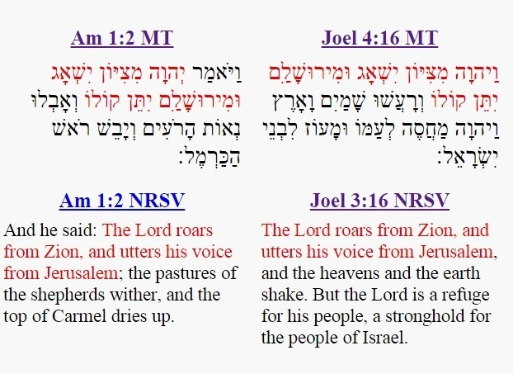
Intertextual References
Quotation: The use of a pre-existing phrase, sentence, or paragraph which is taken from another source

Slide 3
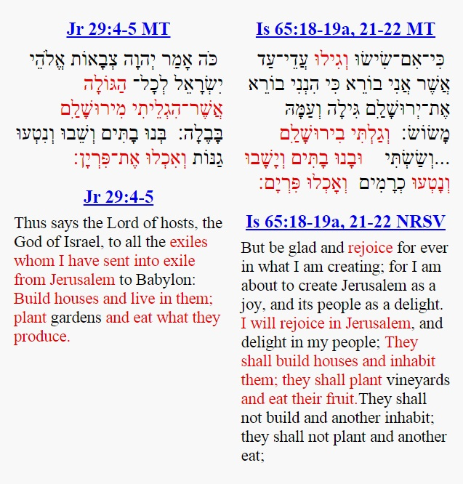
Intertextual References
Allusion: Intentional reference to another text through the use of extended verbal parallel or “catchwords”

Slide 4
Intertextual References
Thematic Parallels: Literary devices that a sophisticated author can embed into a text for a sophisticated reader to “recognize, analyze, and assimilate” in order to convey meaning.
Desolated cities being repopulated with wild beasts
Locusts as a foreign army

Slide 5
Citation Formulae
This was to fulfill what was spoken by the prophet Isaiah…
As it is written…
As for that which he said… interpreted, this concerns the Wicked Priest…

Slide 6
Text-Forms and Recensions
Rev 1:4-5 | Exod 3:14 LXX | Ps 88:37-38 LXX
· χάρις ὑμῖν καὶ εἰρήνη ἀπὸ ὁ ὢν καὶ ὁ ἦν καὶ ὁ ἐρχόμενος καὶ ἀπὸ τῶν ἑπτὰ πνευμάτων ἃ ἐνώπιον τοῦ θρόνου αὐτοῦ καὶ ἀπὸ Ἰησοῦ Χριστοῦ, ὁ μάρτυς, ὁ πιστός, … | καὶ εἶπεν ὁ θεὸς πρὸς Μωυσῆν ἐγώ εἰμι ὁ ὤν καὶ εἶπεν οὕτως ἐρεῖς τοῖς υἱοῖς Ισραηλ ὁ ὢν ἀπέσταλκέν με πρὸς ὑμᾶς | τὸ σπέρμα αὐτοῦ εἰς τὸν αἰῶνα μενεῖ καὶ ὁ θρόνος αὐτοῦ ὡς ὁ ἥλιος ἐναντίον μου καὶ ὡς ἡ σελήνη κατηρτισμένη εἰς τὸν αἰῶνα καὶ ὁ μάρτυς ἐν οὐρανῷ πιστός.
Grace to you and peace from the one who is and the one who was, and the one who is coming, and from the seven spirits which are before his throne, and from Jesus Christ, the faithful witness, … | And God said to Moses “I am the one who is.” And he said “Thus you will say to the Israelites, ‘The one who is has sent me to you.’” | His seed shall remain forever, and his throne [will be] as the sun before me and as the moon which is established forever, and it will be a faithful witness in the heavens.
Rev | Jer 28:45 LXX | Jer 51:45 MT
ἐξέλθατε ὁ λαός μου ἐξ αὐτῆς (Rev 18:4b) | [Lacking] | יצְא֤וּ מִתּוֹכָהּ֙ עַמִּ֔
Come out from her my people! | [Lacking] | Come out from her midst my people!

Slide 7
Revelation and the Prophets

Slide 8
Enumerated Allusions

Slide 9
Expanding Allusions

Slide 10
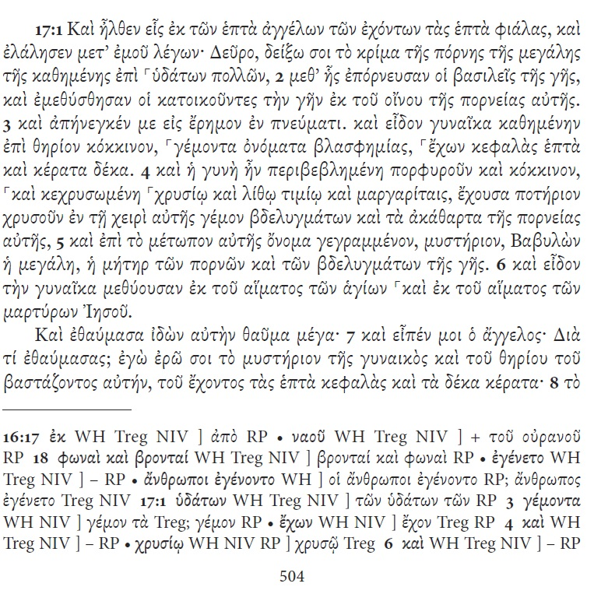
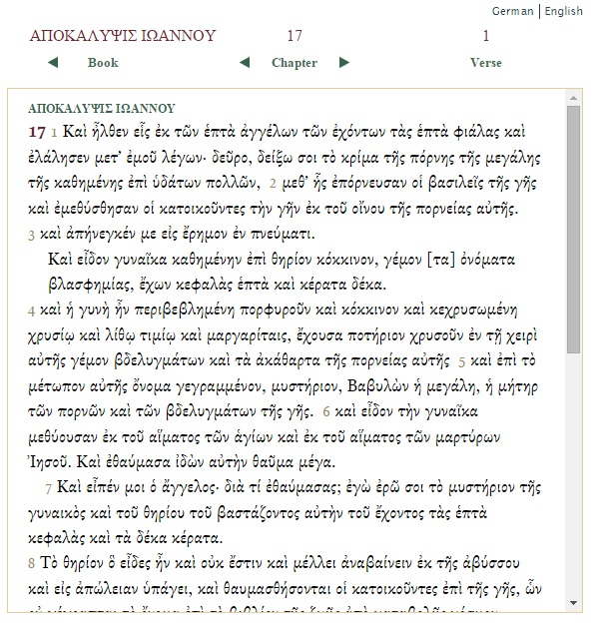
SBLGNT and NA²⁸ Online

Slide 11
Digital Editions
Go to http://encodingrevelation.github.io/revelation/revelation/chapter/ap17.html

